Slide 1

NOSQL
Rahul Bansal
7620987578
3/25/16
-------------NOSQL-------------

Slide 2

Introduction
NoSQL is a non-relational database management systems, different from traditional relational database management systems in some significant ways. It is designed for distributed data stores where very large scale of data storing needs (for example Google or Facebook which collects terabytes of data every day for their users). These type of data storing may not require fixed schema, avoid join operations and typically scale horizontally.
3/25/16
-------------NOSQL-------------

Slide 3
Why NoSQL ?
In today’s time data is becoming easier to access and capture through third parties such as Facebook, Google+ and others.
  Personal user information
  Social graphs
  Geo location data
  User-generated content and machine logging data are just a few examples where the data has been increasing exponentially.
  To avail the above service properly, it is required to process huge amount of data.
  Which SQL databases were never designed. The evolution of NoSql databases is to handle these huge data properly.
3/25/16
-------------NOSQL-------------

Slide 4
Difference between
RDBMS vs NoSQL
RDBMS
NoSQL
- Stands for Not Only SQL
- No declarative query language
- No predefined schema
- Key-Value pair storage, Column Store, Document Store, Graph databases
- Eventual consistency rather ACID property
- Unstructured and unpredictable data
- CAP Theorem
- Prioritizes high performance, high availability and scalability
- Structured and organized data
- Structured query language (SQL)
- Data and its relationships are stored in separate tables.
- Data Manipulation Language, Data Definition Language
- Tight Consistency
- BASE Transaction
3/25/16
-------------NOSQL-------------

Slide 5
Brief history of NoSQL
The term NoSQL was coined by Carlo Strozzi in the year 1998. He used this term to name his Open Source, Light Weight, DataBase which did not have an SQL interface.
In the early 2009, when last.fm wanted to organize an event on open-source distributed databases, Eric Evans, a Rackspace employee, reused the term to refer databases which are non-relational, distributed, and does not conform to atomicity, consistency, isolation, durability - four obvious features of traditional relational database systems.
In the same year, the "no:sql(east)" conference held in Atlanta, USA, NoSQL was discussed and debated a lot.
And then, discussion and practice of NoSQL got a momentum, and NoSQL saw an unprecedented growth.
3/25/16
-------------NOSQL-------------

Slide 6
CAP Theorem (Brewer’s Theorem)
CAP theorem states that there are three basic requirements which exist in a special relation when designing applications for a distributed architecture.
Consistency - This means that the data in the database remains consistent after the execution of an operation. For example after an update operation all clients see the same data.
Availability - This means that the system is always on (service guarantee availability), no downtime.
Partition Tolerance - This means that the system continues to function even the communication among the servers is unreliable, i.e. the servers may be partitioned into multiple groups that cannot communicate with one another.
3/25/16
-------------NOSQL-------------

Slide 7
In theoretically it is impossible to fulfill all 3 requirements. CAP provides the basic requirements for a distributed system to follow 2 of the 3 requirements. Therefore all the current NoSQL database follow the different combinations of the C, A, P from the CAP theorem. Here is the brief description of three combinations CA, CP, AP :
CA - Single site cluster, therefore all nodes are always in contact. When a partition occurs, the system blocks.
CP - Some data may not be accessible, but the rest is still consistent/accurate.
AP - System is still available under partitioning, but some of the data returned may be inaccurate.
3/25/16
-------------NOSQL-------------

Slide 8
What is MongoDb?
MongoDb is a Open Source database written in C++.
Drivers and client libraries are typically written in their respective languages, although some drivers use C extensions for better performance.
If the load increases, by adding more nodes (such as a computer), the performance can be retained.
It can be used to store data for very high performance applications (for example Foursquare is using it in production).
MongoDB does not support SQL It supports a rich, ad-hoc query language of its own.
MongoDb stores data as documents. So it is a document oriented database.
FirstName="Arun", Address="St. Xavier's Road", Spouse=[{Name:"Kiran"}], Children=[{Name:"Rihit", Age:8}].
Notice there are two different documents (separated by "."). Storing data in this fashion is called as document oriented database. MongoDb is a document oriented database.
FirstName="Sameer",Address="8 Gandhi Road".
3/25/16
-------------NOSQL-------------

Slide 9
Architecture Description
The KVStore is a collection of Storage Nodes which host a set of Replication Nodes.
A Storage Node is a physical (or virtual) machine with its own local storage.
A Replication Node can be thought of as a single database which contains key-value pairs
Every Storage Node hosts one or more Replication Nodes as determined by its capacity, a rough measure of the hardware resources associated with it.

Slide 10
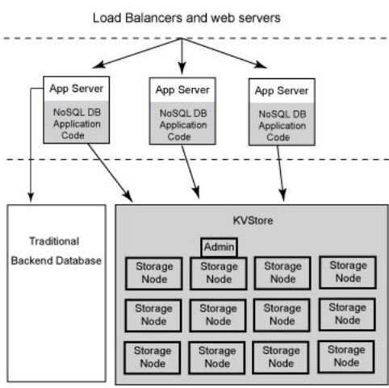
Architecture

Slide 11
MongoDB CRUD Operations
MongoDB CRUD Introduction
  MongoDB stores data in the form of documents, which are JSON-like field and value pairs.
  Documents are analogous to structures in programming languages that associate keys with values (e.g. dictionaries, hashes, maps, and associative arrays).
  Formally, MongoDB documents are BSON documents.
  BSON is a binary representation of JSON with additional type information. In the documents, the value of a field can be any of the BSON data types, including other documents, arrays, and arrays of documents.
3/25/16
-------------NOSQL-------------

Slide 12
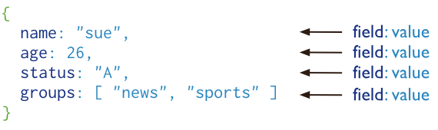
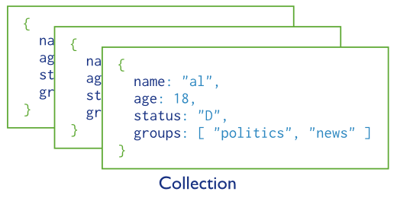
MongoDB stores all documents in collections. A collection is a group of related documents that have a set of shared common indexes. Collections are analogous to a table in relational databases.
3/25/16
-------------NOSQL-------------

Slide 13
Start Working With MongoDB
Installed MongoDB.
Open Command Prompt.
Reach to the MongoDB folder where installed.
cd bin
Create a folder “mongodb\data”
Run mongod.exe --dbpath “d:\set up\mongodb\data”
Open Another Command Prompt.
Reach to the MongoDB folder where installed.
cd bin
mongo.exe
Now You Connected to MongoDB
3/25/16
-------------NOSQL-------------

Slide 14
Show All DataBases :-
  show dbs
Move inside the DataBase
  Use database name
  Use student
    > use student
switched to db student
Get all the Collections
  show collections
shows all the collections name
Create Collection
  db.createCollection(name);
  db.createCollection(name,options)
  db.createCollection(name,
3/25/16
-------------NOSQL-------------

Slide 15
Get All the data from the collections
  Select * from studentdata;
  db.StudentData.find();
Print the data in Json Format
  db.StudentData.find().pretty();
Print Specific Columns
  Select id,first_name from StudentData;
  db.StudentData.find({},{id:1,first_name:1});
Insert Data into the Collection
  Insert into studentdata values(ffsdfsf);
  db.StudentData.insert({id:107,first_name:"Suman",last_name:"Aggarwal",age:35,sex:"F",course_id:20,location:"Mumbai",Address:"102"});
Insert Json inside Json
  db.StudentData.insert({id:108,first_name:"Suman1",last_name:"Aggarwal1",age:35,sex:"F",course_id:20,location:"Mumbai",Address: {houseno : 101,road:"nagar road",pincode:451295}});
3/25/16
-------------NOSQL-------------

Slide 16
Insert Json with group of values
db.StudentData.insert(
{
id:109,
first_name:"Suman2",
last_name:"Aggarwal2",
age:35,sex:"F",
course_id:20,
location:"Mumbai",
Address: {
houseno : 101,
road:"nagar road",
pincode:451295
},
Departmentid : [10,20,30]
}
);
3/25/16
-------------NOSQL-------------

Slide 17
Update the Existing Document :-
  db.StudentData.update({id:109},{$set : {last_name : "Aggarwal"}});
  db.StudentData.update({age : {$gt : 34}},{$set : {last_name : "Aggarwal1"}});
  db.StudentData.update({id:109},{$set : {new_field : “Test"}});
  db.StudentData.update({"id":110},{$set : {"new_fields":1}})
Add the New Column to the existing document
  db.StudentData.update({id: 109},{$set : {new_field:"Test"}},false,true);
  False and true :: upsert(create new document if not matched) multi(update multiple documents)
Clear Screen
  Ctrl + l
3/25/16
-------------NOSQL-------------

Slide 18
Delete the Document
  db.StudentData.remove({"_id":ObjectId("56ee300dcf8257bedf8ec7d7“)});
Drop the Collection
  db.collection.drop()
Limit the Rows
  db.StudentData.find({},{id:1,first_name:1}).limit(3);
Create Index :: Primary Key
  db.StudentData.createIndex( { id: 1 }, { unique: true } )
3/25/16
-------------NOSQL-------------

